Slide 1

Techno india njr institute of Technology, Udaipur
Computer Science &Engineering
May 2023

Slide 2
EMofy
A mood based music player

Slide 3
Submitted By:
Soumya Jaitawat 19ETCCS067
Bhavini Jain 19ETCCS008
Harshit Chaubisa 19ETCCS024
Nandeshwari Ranawat 19ETCCS041
Submitted to:
Mr. Aaditya Maheshwari
Head of Industry project
TNJRIT , Udaipur

Slide 4
Problem Statement
Music preferences vary based on moods and emotions
Existing music players do not effectively cater to users' changing moods
Lack of personalized music recommendations based on mood

Slide 5
Solution Overview
Mood-Based Music Recommendation Player: A revolutionary approach
Analyzes users' moods and recommends suitable music
Seamlessly integrates with existing music platforms

Slide 6
Key Features
Mood Detection: Advanced algorithms analyze users' moods in real-time
Mood Mapping: Assigns music genres and playlists to specific moods
Personalization: Learns user preferences and adapts recommendations over time
Integration: Compatible with popular music streaming platforms (Spotify).

Slide 7
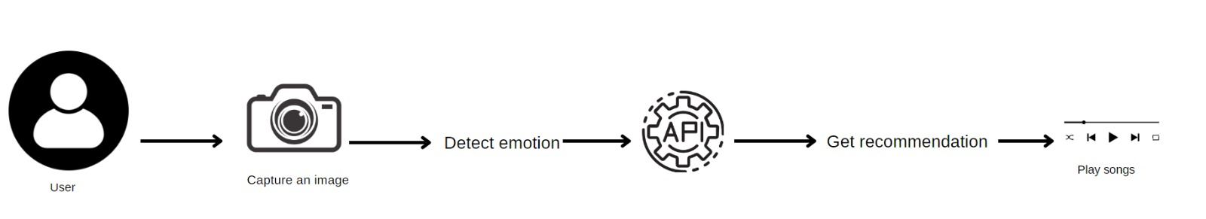
Workflow
………………………….

Slide 8
Benefits
Enhanced Music Experience: Tailored music recommendations to suit users' moods
Discover New Music: Expose users to different genres and artists
Improved Productivity: Energizing or relaxing music based on mood
Customer Retention: Increased user engagement and satisfaction

Slide 9
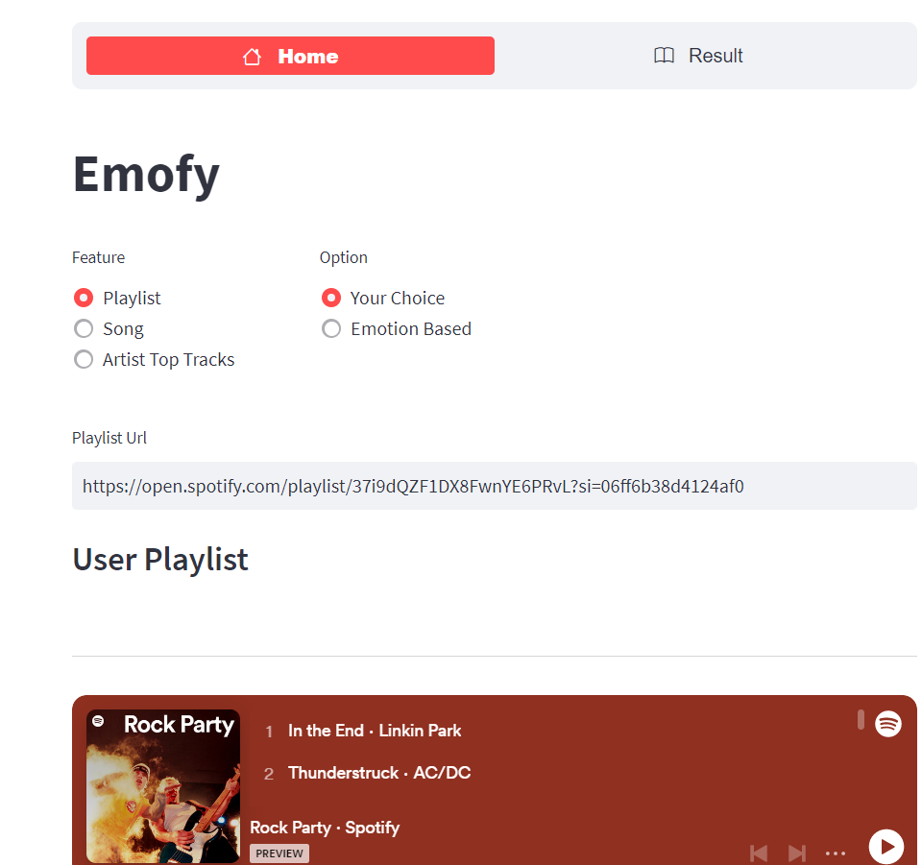
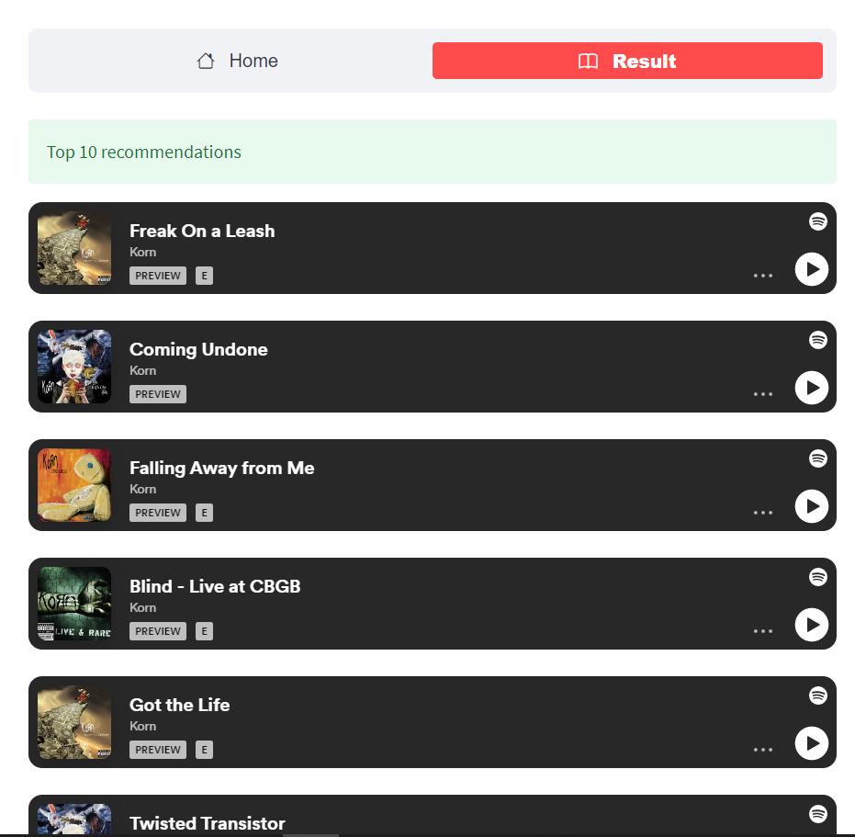
Snapshots

Slide 10
Conclusion & Future Scope
“
”
Mood-Based Music Recommendation Player: The future of personalized music experiences
Improving the way people enjoy music based on their moods.
Machine Learning and AI advancements for more accurate mood detection
Integration with wearable devices for real-time mood monitoring
Expansion into other media platforms (movies, TV shows, etc.)

Slide 11
THANK YOU

